Slide 1

Empirical Analysis of Robust Federated Learning under Differential Privacy
Sedat Çoban
Master Thesis Final Presentation
Professorship of Coding and Cryptography
School of Computation, Information and Technology
Technical University of Munich
08. July 2025

Slide 2
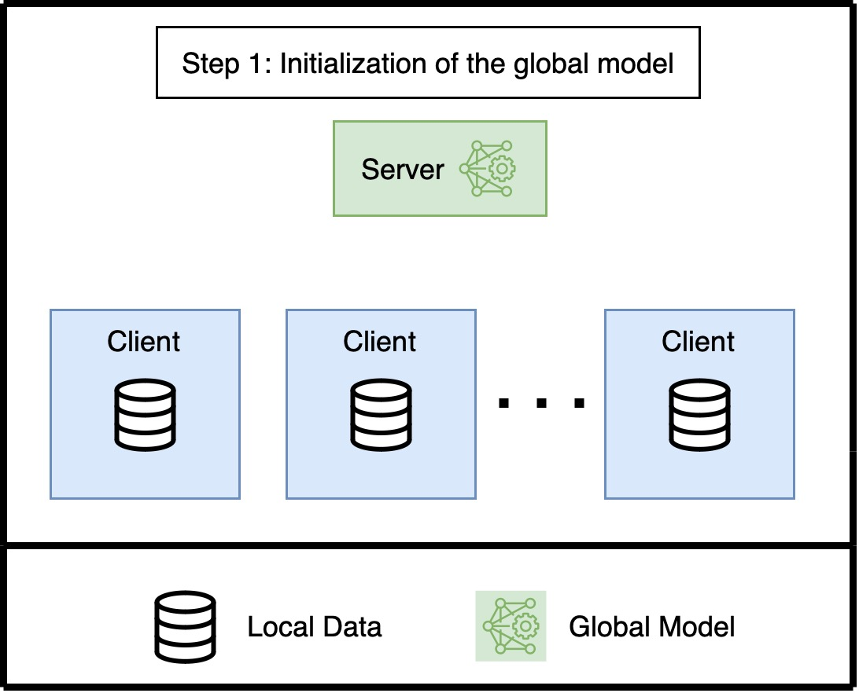
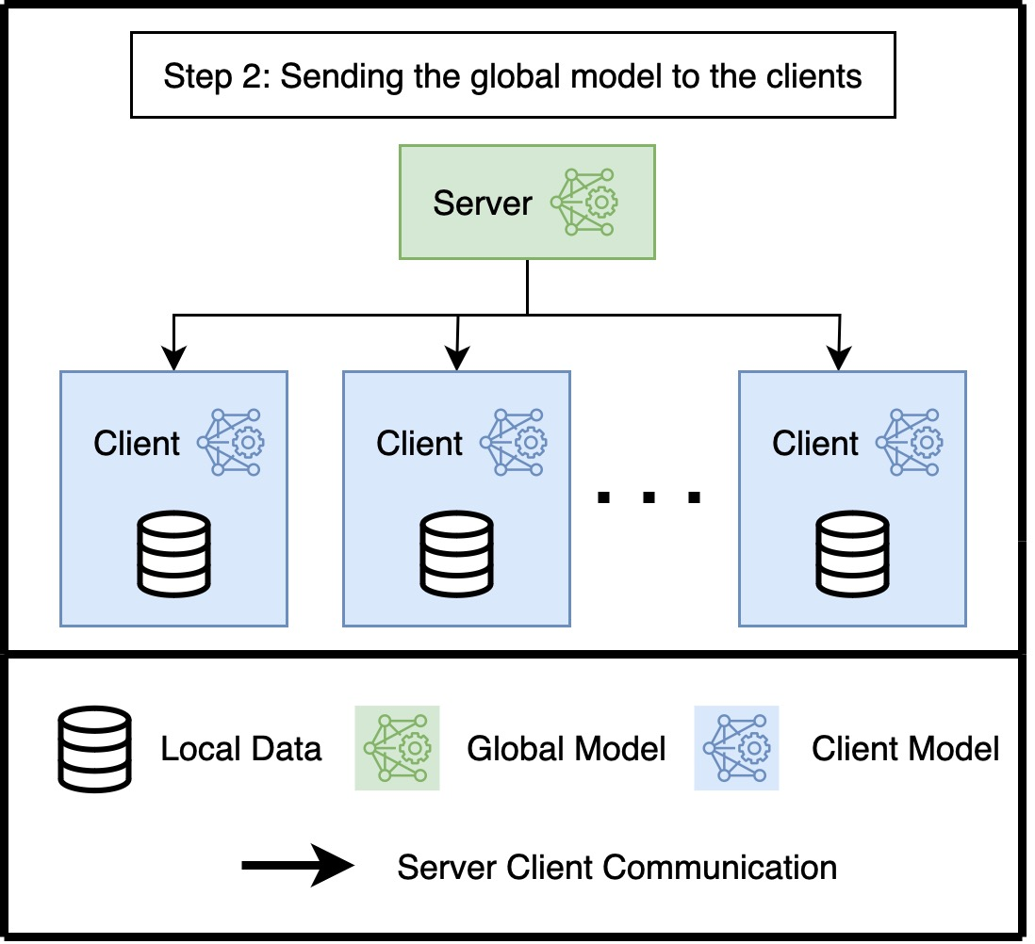
Federated Learning – Initialization

Slide 3
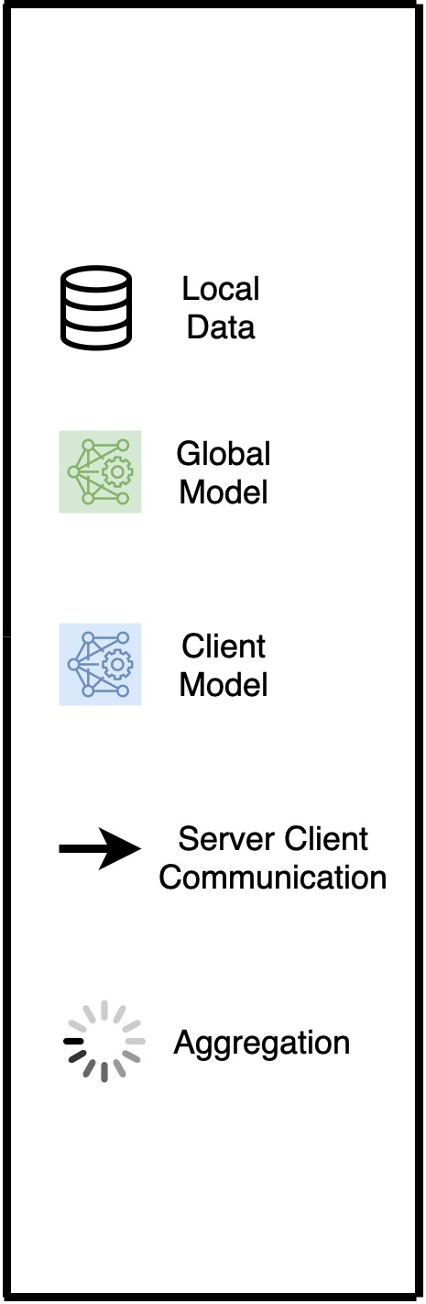
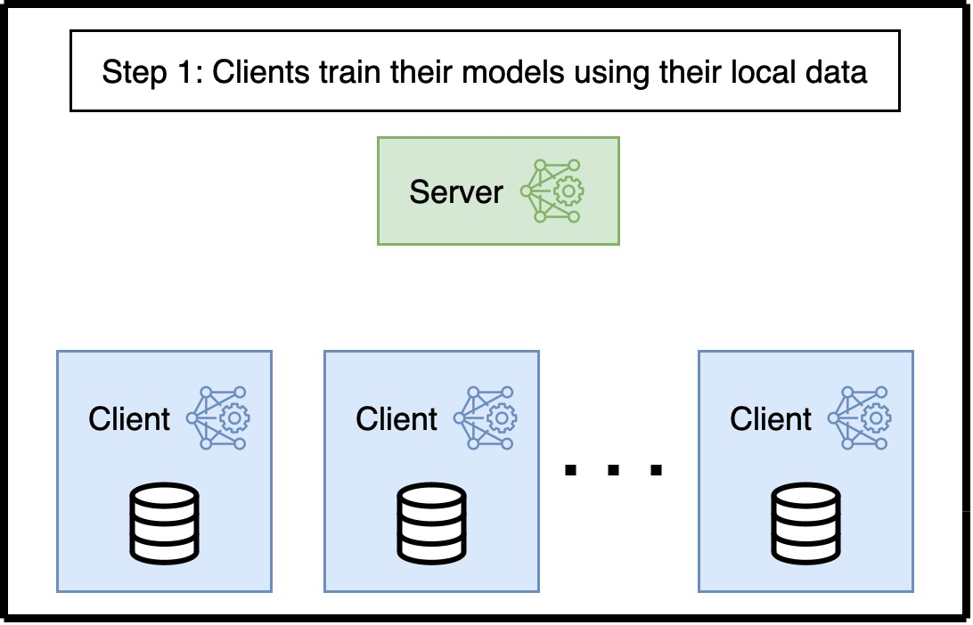
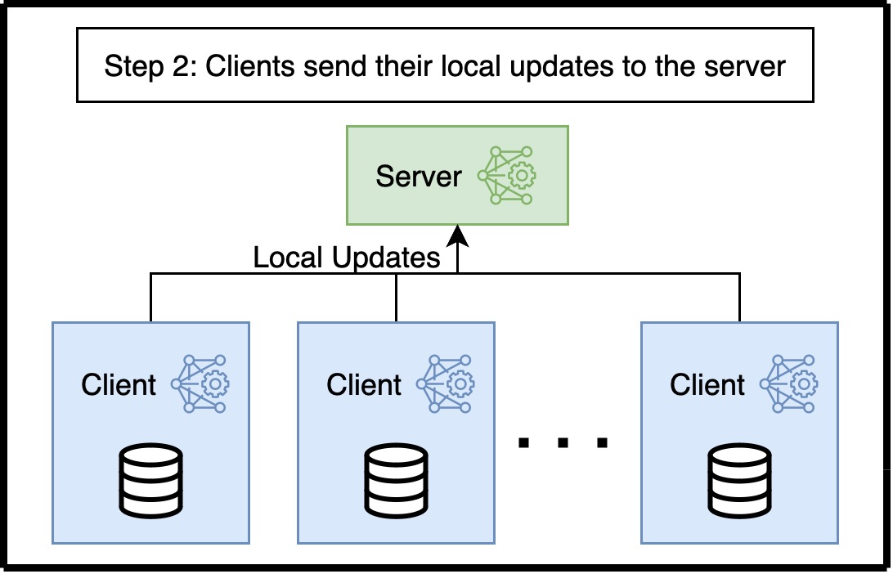
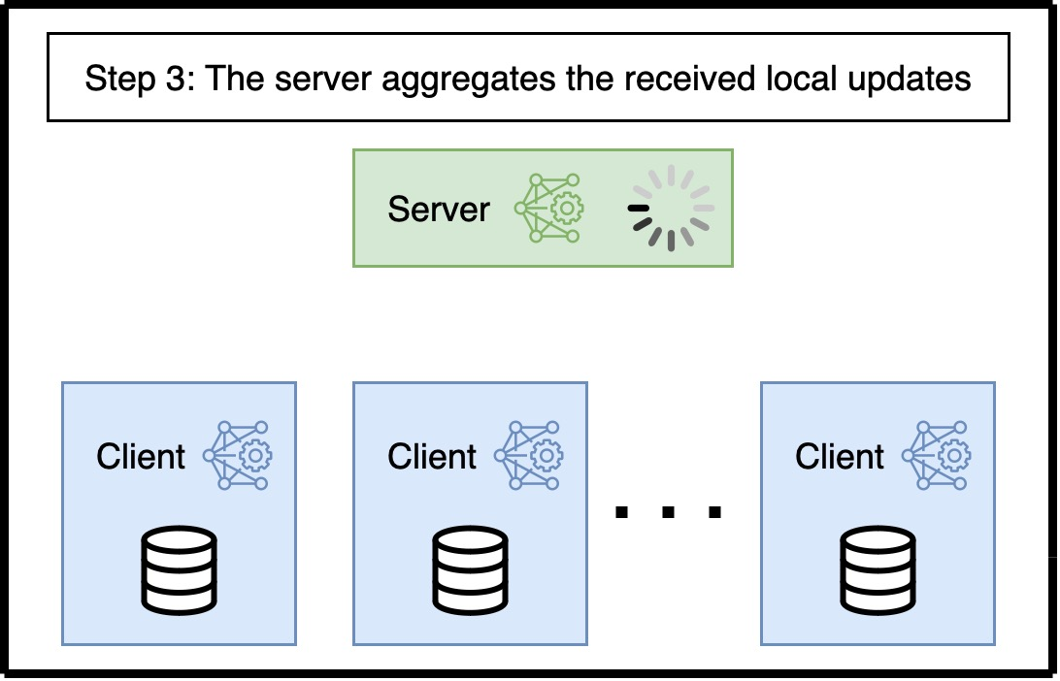
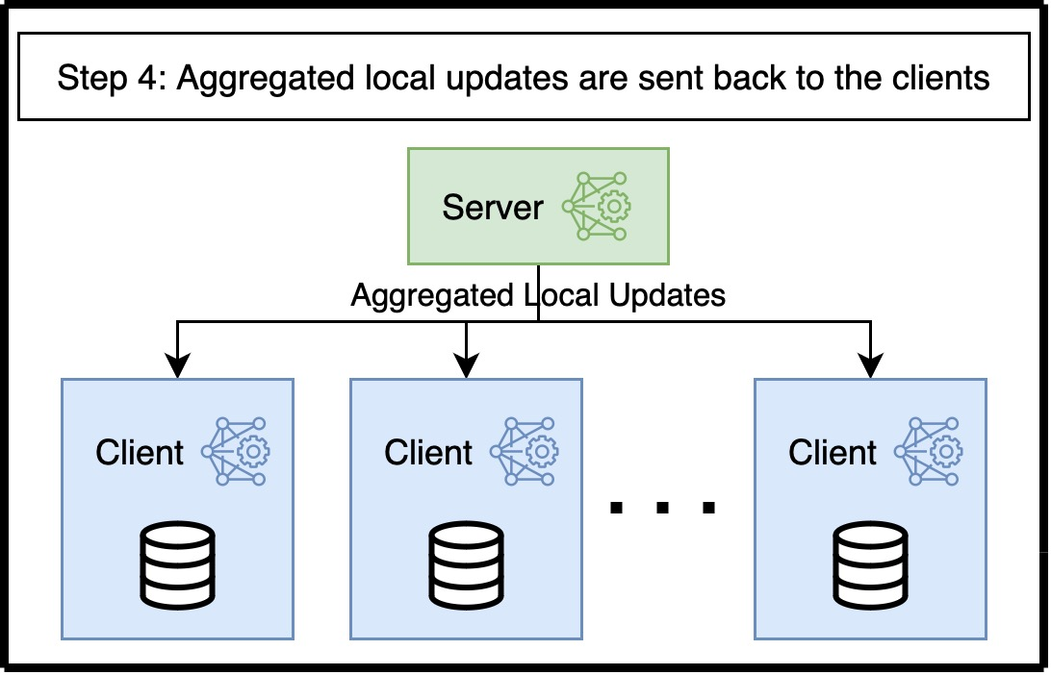
Federated Learning – Training

Slide 4


Our Aim
Federated Learning is privacy-preserving by design.
Recent studies suggest that it may not provide sufficient protection against privacy attacks.¹
As a result, Local Differential Privacy (LDP) is applied to protect the system from privacy attacks.¹
LDP-enhanced federated learning has rarely been evaluated under robust aggregation methods.^{2,3}
Main goal: Empirical analysis of different robust aggregation methods under adversarial attacks with local differential privacy by focusing on the accuracy results.

Slide 5
Adversaries Attacks
Benign clients follow the training protocol honestly.
Malicious clients disrupt the global model through model poisoning or data poisoning.
Model poisoning is manipulating the local updates sent to the server.
Data poisoning is using misleading or corrupted local data.

Slide 6
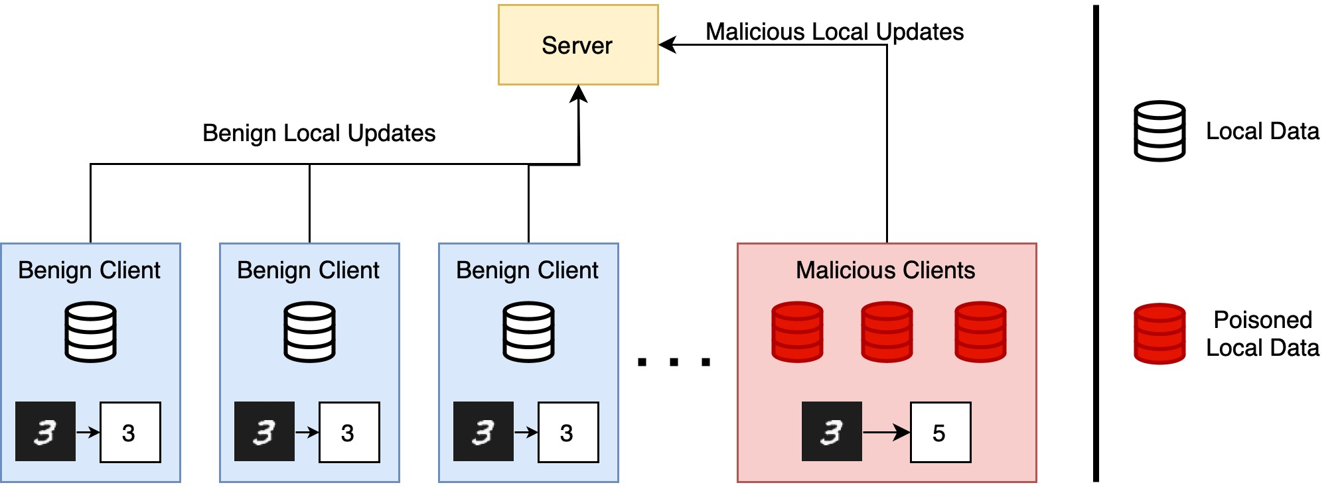
Attack Type – Data Poisoning (Label Flipping⁴)

Slide 7
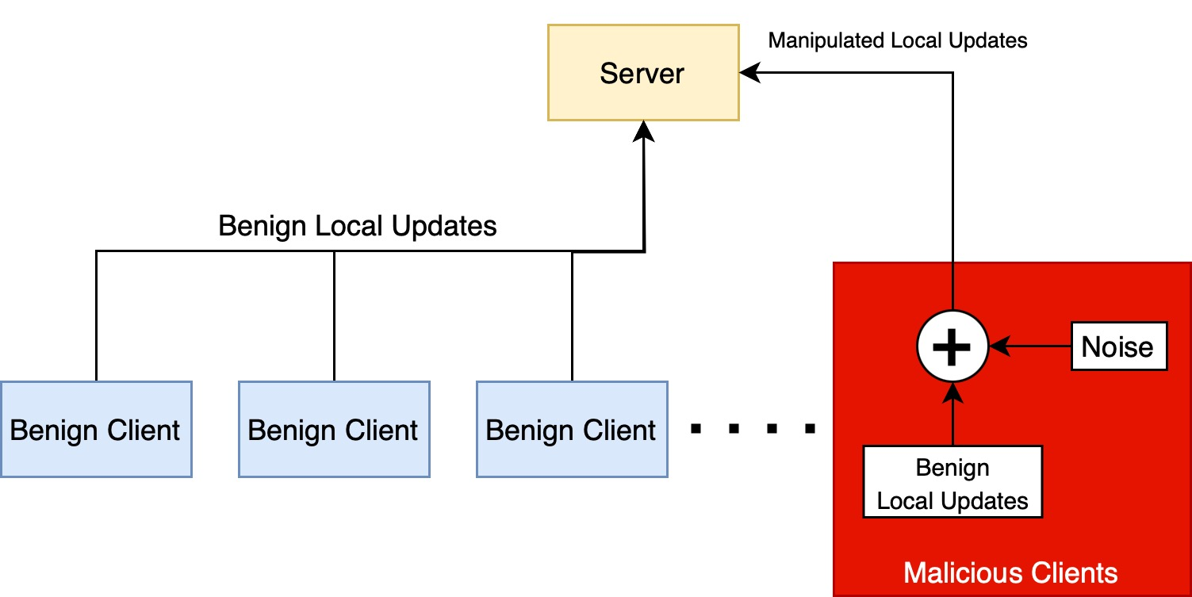
Attack Type – Model Poisoning (Random Gaussian⁵)

Slide 8
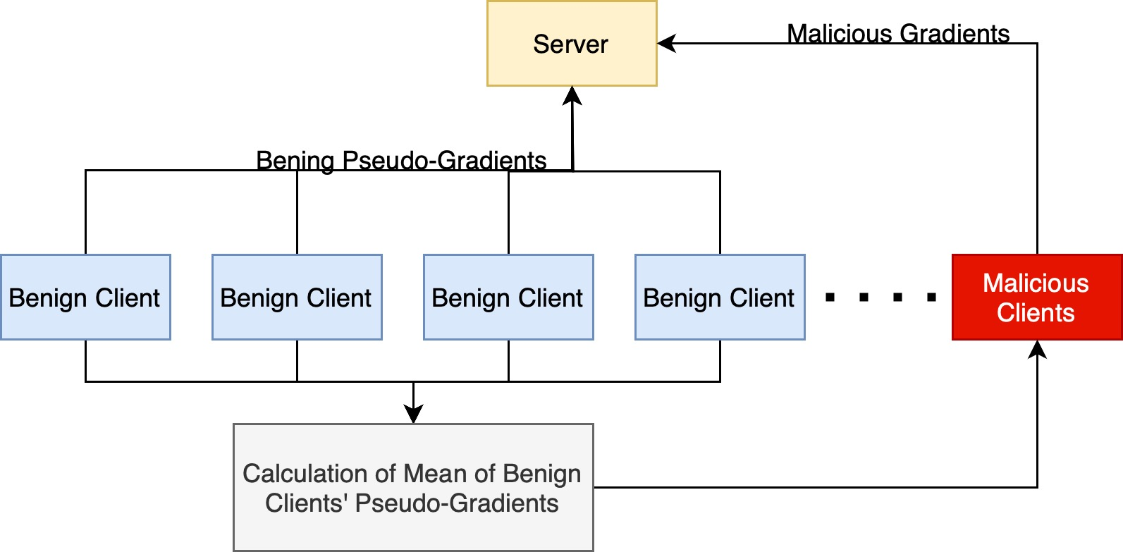
Attack Type – Model Poisoning (IPM⁶)

Slide 9
Robust Aggregation Methods
Aggregation Method | Underlying Principle | Assumptions - Hyperparameters
Krum (Blanchard et al. ‘17) | Euclidean Distance | Needs to know number of malicious clients
Multi-Krum (Blanchard et al. ‘17) | Euclidean Distance | Needs to know number of malicious clients
Bulyan (El Mahdi et al. ’18) | Krum and Coordinate-wise Median | Needs to know number of malicious clients
Trimmed Mean (Yin et al. '21) | Coordinate-wise Trimmed Average | Needs to know number of malicious clients
Median (Yin et al. '21) | Coordinate-wise Median | -
Geometric Median (Chen et al. ‘17) | Geometric Median | Assumption on the maximum number of malicious clients
Centered Clipping (Karimireddy et al. '21) | Clipping | Clipping Threshold
Clustering (Sattler et al. ‘20) | Cosine Similarity | Clustering Threshold
Clipped Clustering (Li et al. ‘24) | Clipping and Cosine Similarity | Clipping Threshold, Clustering Threshold
CosDefense (Nur et al. ’23) | Cosine Similarity | -
Notes:
Group them by their underlying category.

Slide 10
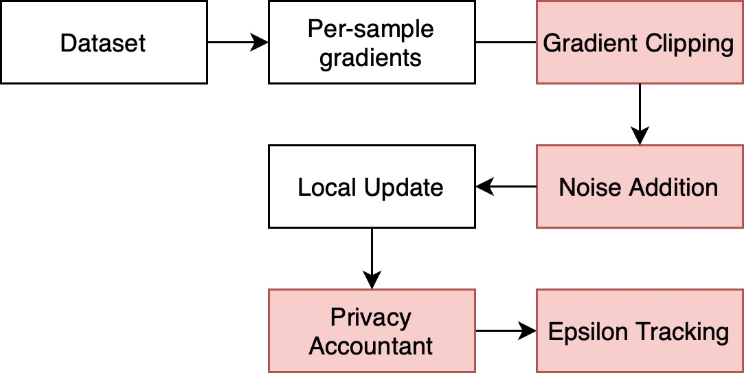
Differential Privacy (Opacus)
Differential Privacy is ensured through gradient clipping and the addition of calibrated noise.
It wraps the model in order model to compute per-sample gradient.⁷
It changes optimizer in order optimizer to perform gradient clipping and adding noise to the gradients.⁷
It changes DataLoader in order to perform Poisson Sampling or Uniform Sampling.⁷
For MNIST dataset, 𝛆 = 5 and for CIFAR-10 dataset, 𝛆 = 8. In both datasets, 𝜹 = 1e-3 and gradient clipping is set to 2.0.

Slide 11
Accuracy Results for MNIST - IID
Method | No Attack w/out LDP | No Attack with LDP | Random Gaussian w/out LDP | Random Gaussian with LDP | IPM w/out LDP | IPM with LDP | Label Flipping w/out LDP | Label Flipping with LDP
FedAverage | 98.89 | 92.82 | 9.80 | 12.56 | 98.60 | 89.88 | 98.26 | 91.04
Krum | 94.09 | 80.53 | 94.29 | 79.99 | 10.32 | 9,80 | 94.17 | 79.06
Mkrum | 98.77 | 92.36 | 98.86 | 92.29 | 94.71 | 71.93 | 98.87 | 89.84
Median | 98.74 | 91.29 | 98.80 | 90.91 | 94.70 | 7.73 | 98.57 | 88.50
Centered Clipping | 98.96 | 67.92 | 98.84 | 66.38 | 98.52 | 57.21 | 98.86 | 66.04
Clustering | 98.70 | 92.56 | 98.76 | 92.05 | 93.94 | 0.84 | 98.63 | 90.87
Clipped Clustering | 98.90 | 91.26 | 95.13 | 65.36 | 98.58 | 82.98 | 98.95 | 89.84
Cos Defence | 98.84 | 92.20 | 90.44 | 56.03 | 98.89 | 91.39 | 98.94 | 90.68
Trimmed Mean | 98.93 | 92.82 | 98.88 | 92.24 | 97.70 | 86.65 | 98.56 | 91.02
Geometric Median | 98.92 | 92.85 | 98.72 | 86.83 | 98.53 | 89.66 | 93.46 | 91.10
Bulyan | 98.89 | 92.82 | 98.69 | 91.96 | Cannot run with 40% malicious clients |  | 98.75 | 89.51
Common: 80 Epochs, 100 Clients, 1 Local Iteration, Batch size 64, Dirichlet alpha 100 Attack Cases: 20% malicious clients for Random Gaussian and Label Flipping (100% flipping). 40% malicious clients for IPM.
Notes:
In literature it is common to use delta as the inverse of the sample size of a client

Slide 12
Accuracy Results for MNIST – Non-IID
Method | No Attack w/out LDP | No Attack with LDP | Random Gaussian w/out LDP | Random Gaussian with LDP | IPM w/out LDP | IPM with LDP | Label Flipping w/out LDP | Label Flipping with LDP
FedAverage | 98.85 | 90.56 | 9.80 | 12.75 | 98.41 | 89.13 | 95.14 | 89.33
Krum | 95.19 | 30.14 | 94.22 | 29.94 | 11.35 | 7.54 | 93.64 | 30.14
Mkrum | 98.31 | 88.60 | 98.50 | 89.50 | 11.35 | 10.73 | 98.42 | 83.25
Median | 98.37 | 88.52 | 98.41 | 88.41 | 19.30 | 9.74 | 98.26 | 84.96
Centered Clipping | 98.79 | 67.67 | 98.72 | 58.30 | 98.11 | 21.52 | 98.65 | 52.00
Clustering | 98.32 | 90.24 | 98.32 | 90.22 | 11.45 | 9.74 | 98.23 | 87.97
Clipped Clustering | 98.82 | 79.39 | 93.85 | 61.05 | 98.09 | 10.1 | 98.13 | 76.55
Cos Defence | 98.54 | 89.82 | 42.37 | 28.68 | 98.79 | 90.28 | 98.75 | 86.99
Trimmed Mean | 98.82 | 90.62 | 98.74 | 90.99 | 96.73 | 83.51 | 98.42 | 88.73
Geometric Median | 98.83 | 90.60 | 98.74 | 84.19 | 98.07 | 88.06 | 98.43 | 89.12
Bulyan | 98.86 | 90.62 | 98.13 | 89.05 | Cannot run with %40 malicious clients |  | 98.24 | 83.06
Common: 80 Epochs, 100 Clients, 1 Local Iteration, Batch size 64, Dirichlet alpha 0.5 Attack Cases: 20% malicious clients for Random Gaussian and Label Flipping (100% flipping). 40% malicious clients for IPM.
Notes:
Add a backup slide for the experimental setup.

Slide 13
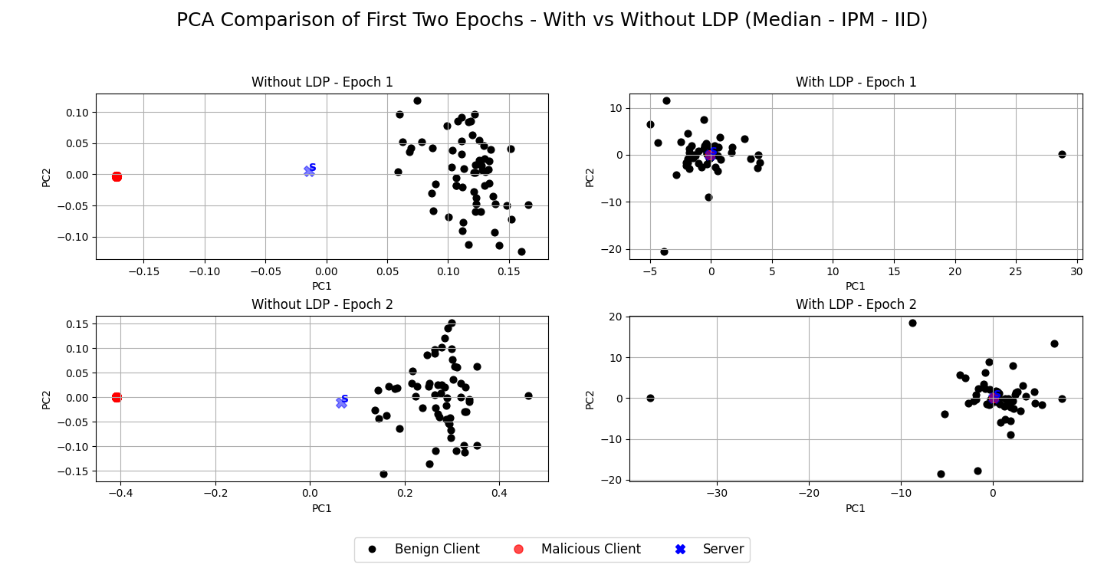
Median Under IPM Attack (MNIST – IID)
Test accuracy drops from 94.7% to 7.73%

Slide 14
Centered Clipping Under All Attack Scenarios (MNIST – IID and Non-IID)
Test accuracy drops from 98.96% to 67.92% for No-attack scenario. (IID)
Test accuracy drops from 98.84% to 66.38% for Random Gaussian attack scenario. (IID)
Test accuracy drops from 98.52% to 57.21% for IPM attack scenario. (IID)
Test accuracy drops from 98.86% to 66.04% for Label Flipping attack scenario. (IID)
Test accuracy drops from 98.79% to 67.67% for No-attack scenario. (Non-IID)
Test accuracy drops from 98.72% to 58.30% for Random Gaussian attack scenario. (Non-IID)
Test accuracy drops from 98.11% to 21.52% for IPM attack scenario. (Non-IID)
Test accuracy drops from 98.65% to 52.00% for Label Flipping attack scenario. (Non-IID)

Slide 15
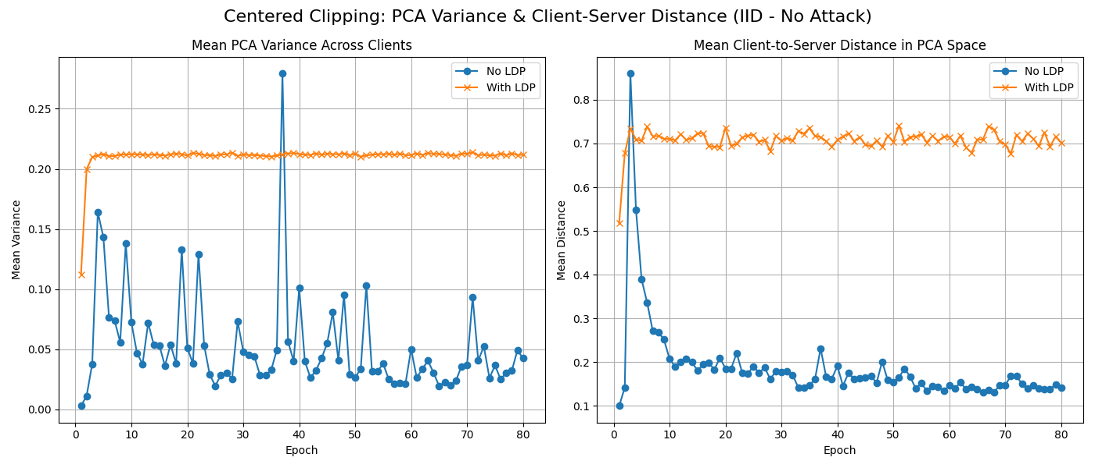
Centered Clipping Under All Attack Scenarios (MNIST – IID and Non-IID)

Slide 16
Krum Under All Attack Scenarios (MNIST – Non-IID)
Test accuracy drops from 95.19% to 30.14% for No-attack scenario.
Test accuracy drops from 94.22% to 29.94% for Random Gaussian attack scenario.
Test accuracy drops from 93.64% to 30.14% for Label Flipping attack scenario.

Slide 17
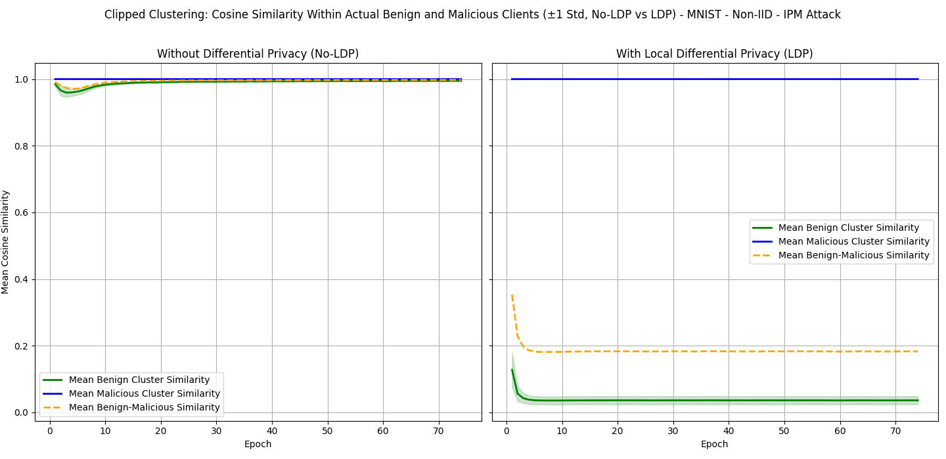
Clipped Clustering Under IPM Attack (MNIST – Non-IID)
Test accuracy drops from 98.09% to 10.10%.

Slide 18
Accuracy Results for CIFAR-10 - IID
Method | No Attack w/out LDP | No Attack with LDP | Random Gaussian w/out LDP | Random Gaussian with LDP | IPM w/out LDP | IPM with LDP | Label Flipping w/out LDP | Label Flipping with LDP
FedAverage | 82.18 | 61.38 | 12.52 | 10.00 | 80.54 | 57.68 | 80.54 | 57.69
Krum | 61.24 | 35.64 | 62.19 | 35.34 | 10.00 | 10.00 | 44.15 | 36.23
Mkrum | 79.26 | 56.41 | 79.52 | 57.03 | 74.81 | 14.43 | 76.32 | 31.81
Median | 78.18 | 10.19 | 72.32 | 11.27 | 12.26 | 10.00 | 75.53 | 11.87
Centered Clipping | 58.98 | 24.98 | 54.62 | 23.09 | 26.67 | 10.00 | 58.05 | 20.44
Clustering | 81.89 | 58.54 | 81.00 | 56.59 | 33.55 | 10.00 | 81.36 | 55.50
Clipped Clustering | 82.26 | 61.02 | 10.00 | 10.00 | 80.49 | 55.62 | 81.00 | 56.61
Cos Defence | 80.37 | 59.25 | 80.10 | 11.75 | 78.12 | 57.74 | 80.46 | 51.57
Trimmed Mean | 82.22 | 61.33 | 81.13 | 57.61 | 80.17 | 51.27 | 81.48 | 57.19
Geometric Median | 82.30 | 61.34 | 78.88 | 53.03 | 80.52 | 56.58 | 79.54 | 57.47
Bulyan | 82.17 | 61.31 | 80.15 | 53.81 | Cannot run with 40% malicious clients |  | 79.80 | 51.15
Common: 100 Epochs, 20 Clients, 1 Local Iteration, Batch size 128, Dirichlet alpha 100 Attack Cases: 20% malicious clients for Random Gaussian and Label Flipping (100% flipping). 40% malicious clients for IPM.
Notes:
Talk about the transaction more complex data and stuff.

Slide 19
Accuracy Results for CIFAR-10 – Non-IID
Method | No Attack w/out LDP | No Attack with LDP | Random Gaussian w/out LDP | Random Gaussian with LDP | IPM w/out LDP | IPM with LDP | Label Flipping w/out LDP | Label Flipping with LDP
FedAverage | 75.75 | 58.55 | 10.58 | 9.30 | 71.52 | 47.00 | 52.55 | 46.84
Krum | 44.75 | 10.00 | 39.45 | 10.00 | 10.00 | 10.00 | 19.76 | 10.00
Mkrum | 70.81 | 39.77 | 68.78 | 39.67 | 61.40 | 13.49 | 66.24 | 37.15
Median | 72.86 | 10.00 | 62.30 | 10.00 | 3.23 | 10.00 | 68.71 | 10.00
Centered Clipping | 48.10 | 10.54 | 44.43 | 13.41 | 28.01 | 10.00 | 48.03 | 15.92
Clustering | 78.23 | 53.07 | 76.11 | 50.32 | 8.53 | 10.00 | 72.99 | 44.68
Clipped Clustering | 73.05 | 51.56 | 10.00 | 10.00 | 59.20 | 37.55 | 47.28 | 40.70
Cos Defence | 65.14 | 47.47 | 28.44 | 10.00 | 56.55 | 48.04 | 35.77 | 40.56
Bulyan | 77.13 | 57.26 | 73.48 | 50.06 | Cannot run with 40% malicious clients |  | 68.87 | 38.22
Trimmed Mean | 77.30 | 57.24 | 75.61 | 50.55 | 72.70 | 45.31 | 71.63 | 46.90
Geometric Median | 76.41 | 57.24 | 71.53 | 50.27 | 73.60 | 47.01 | 61.70 | 48.78
Common: 100 Epochs, 20 Clients, 1 Local Iteration, Batch size 128, Dirichlet alpha 0.5 Attack Cases: 20% malicious clients for Random Gaussian and Label Flipping (100% flipping). 40% malicious clients for IPM.

Slide 20
Median Under All Attack Scenarios (CIFAR-10 – IID and Non-IID)
Test accuracy drops from 78.18% to 10.19% for No-attack scenario. (IID)
Test accuracy drops from 72.32% to 11.27% for Random Gaussian attack scenario. (IID)
Test accuracy drops from 75.53% to 11.87% for Label Flipping attack scenario. (IID)
Test accuracy drops from 72.86% to 10.00% for No-attack scenario. (Non-IID)
Test accuracy drops from 62.30% to 10.00% for Random Gaussian attack scenario. (Non-IID)
Test accuracy drops from 68.71% to 10.00% for Label Flipping attack scenario. (Non-IID)

Slide 21
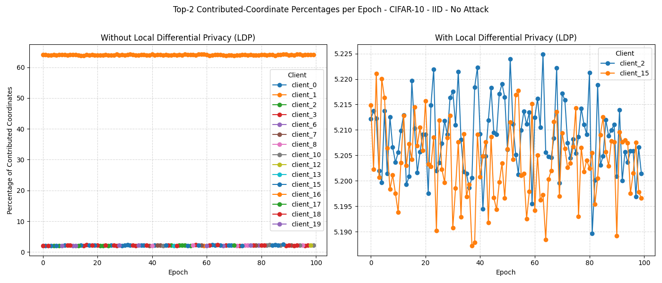
Median Under All Attack Scenarios (CIFAR-10 – IID and Non-IID)

Slide 22
MKrum Under All Attack Scenarios (CIFAR-10 – Non-IID)
Test accuracy drops from 70.81% to 39.77% for No-attack scenario.
Test accuracy drops from 68.78% to 39.67% for Random Gaussian attack scenario.
Test accuracy drops from 61.48% to 13.49% for IPM attack scenario.
Test accuracy drops from 66.24% to 37.15% for Label Flipping attack scenario.

Slide 23
Common Patterns
Euclidean distance-based robust aggregation methods such as Krum and Mkrum under Non-IID partition.
Krum fails under LDP when the model is trained on MNIST.
MKrum fails under LDP when the model is trained on CIFAR-10
There is a common explanation why cosine similarity-based robust aggregation methods such as Clustering, Clipped Clustering and CosDefence fails under LDP.
LDP makes benign clients to be dissimilar from each other.
Depending on the attack type, malicious clients become similar to each other.

Slide 24
Conclusion
Take Aways:
Trimmed Mean and Geometric Median methods can survive under LDP.
Centered Clipping (MNIST – IID and Non-IID), Krum (MNIST – Non-IID), Median (CIFAR-10 - IID and Non-IID) and MKrum (CIFAR-10 – Non-IID) failed under LDP when there is No-attack.
Common patterns:
Euclidean distance-based methods such as Krum and Mkrum under Non-IID distribution.
Cosine similarity-based methods such as Clustering, Clipped Clustering and CosDefense.
Future Directions:
Different 𝛆 values could enable us to reason in which range the robust aggregation methods remain balance and achieve higher test accuracies.
Different LDP mechanism rather than Gaussian could be tested to see the effect on the robust aggregation methods.
Theoretical analysis of robust aggregation methods under LDP.

Slide 27
Appendices

Slide 28
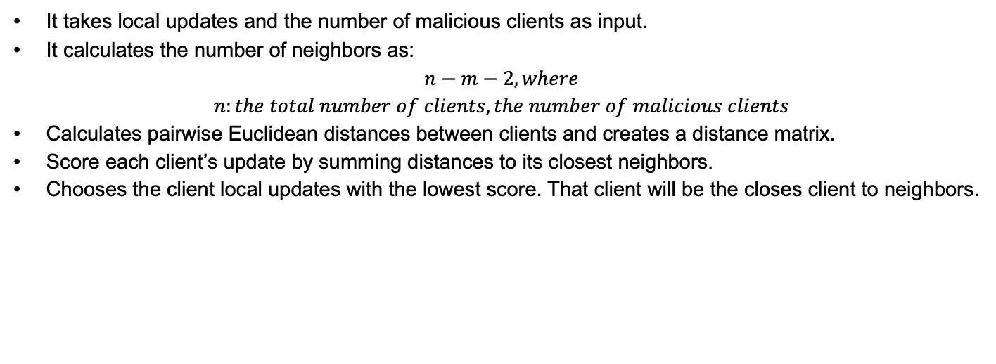
Robust Aggregation Method - Krum
It takes local updates and the number of malicious clients as input.
It calculates the number of neighbors as:
$$n−m−2, where$$
$$n:the total number of clients, the number of malicious clients$$
Calculates pairwise Euclidean distances between clients and creates a distance matrix.
Score each client’s update by summing distances to its closest neighbors.
Chooses the client local updates with the lowest score. That client will be the closes client to neighbors.

Slide 29
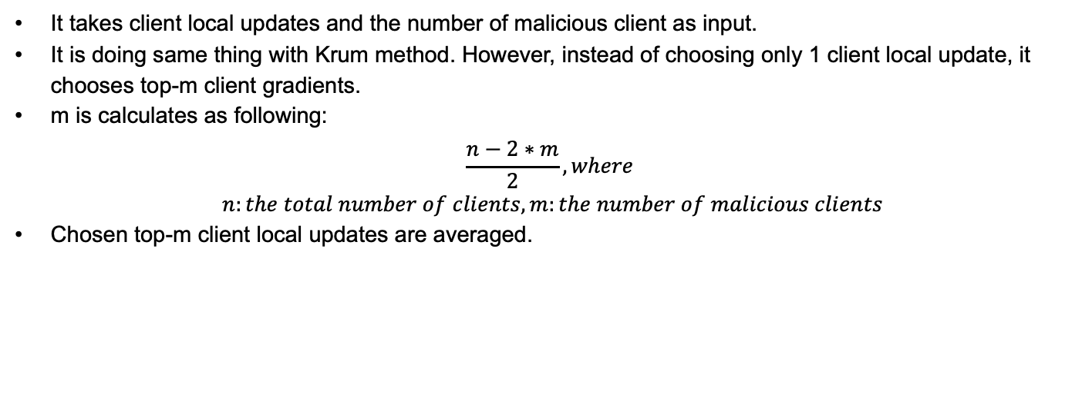
Robust Aggregation Method – Multi-Krum
It takes client local updates and the number of malicious client as input.
It is doing same thing with Krum method. However, instead of choosing only 1 client local update, it chooses top-m client gradients.
m is calculates as following:
$$\frac{n−2∗m}{2}, where$$
$$n:the total number of clients, m:the number of malicious clients$$
Chosen top-m client local updates are averaged.

Slide 30
Robust Aggregation Method – Trimmed Mean
It takes client local updates and number of malicious client as input.
Clients’ local updates are sorted from smallest to largest.
β percentage of client local updates are trimmed from the lowest and largest part.
The remaining client local updates are averaged.

Slide 31
Robust Aggregation Method - Median
It takes client local updates as input.
It finds the median of the client local updates.

Slide 32
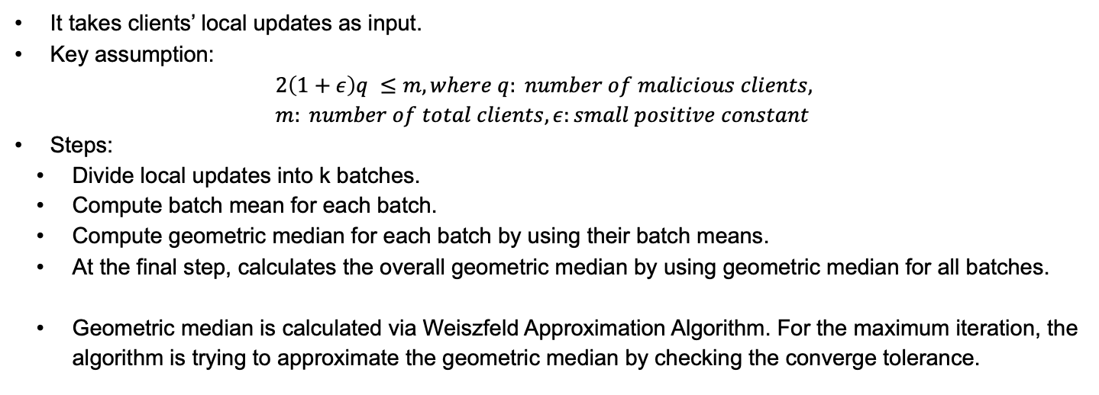
Robust Aggregation Method – Geometric Median
It takes clients’ local updates as input.
Key assumption:
$$2\left(1+ε\right)q ≤m, where q: number of malicious clients, \\ m: number of total clients, ε:small positive constant$$
Steps:
Divide local updates into k batches.
Compute batch mean for each batch.
Compute geometric median for each batch by using their batch means.
At the final step, calculates the overall geometric median by using geometric median for all batches.
Geometric median is calculated via Weiszfeld Approximation Algorithm. For the maximum iteration, the algorithm is trying to approximate the geometric median by checking the converge tolerance.

Slide 33
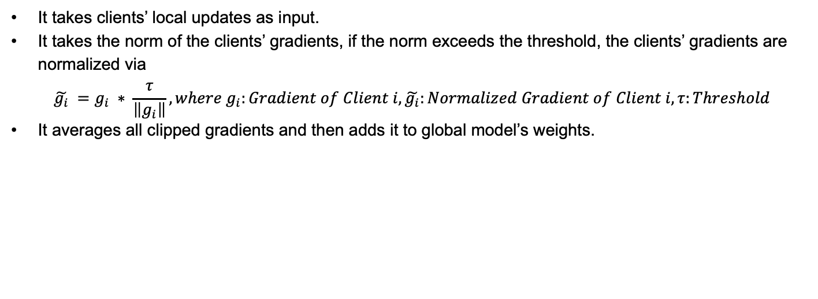
Robust Aggregation Method – Centered Clipping
It takes clients’ local updates as input.
It takes the norm of the clients’ gradients, if the norm exceeds the threshold, the clients’ gradients are normalized via
$${\tilde{g_{i}}}_{ }=g_{i} ∗ \frac{τ}{\left\|g_{i}\right\|}, where g_{i}:Gradient of Client i, \tilde{g_{i}}:Normalized Gradient of Client i, τ:Threshold$$
It averages all clipped gradients and then adds it to global model’s weights.

Slide 34
Robust Aggregation Method - Clustering
It takes clients’ local updates.
It calculates the similarity matrix.
It uses Agglomerative Clustering with complete linkage to create 2 clusters from the similarity matrix.
Agglomerative Clustering: Begins with N groups, each containing initially one client’s local updates, and then the two most similar groups merged at each stage until there are 2 clusters.
After the forming two clusters, the method checks whether those two clusters’ similarity are larger than a threshold or not. If their similarity is larger than the threshold, it considers the cluster with more member as benign cluster, whereas if the similarity is lower than the threshold, the method considers every client as benign client.
Then, the method calculates the median of benign cluster.

Slide 35
Robust Aggregation Method – Clipped Clustering
The method is the combination of clipping and clustering.
The method calculates the norm of the local updates of each clients and checks whether the norm exceeds the threshold or not. If it exceeds, that local update will be normalized.
Later, it performs clustering and chooses the cluster with more members as benign cluster and calculates the average of the benign cluster.

Slide 36
Robust Aggregation Method - CosDefense
It takes local updates and global weight as inputs.
It computes the cosine similarity score between the global weight’s last layer and each client’s last layer update.
Then, it normalizes the scores using min-max scaling for better separation between benign and malicious clients.
It calculates the threshold as the mean of all normalized cosine similarity scores. Clients with scores exceeding the threshold are labeled as malicious.
It aggregates benign updates by averaging.

Slide 37
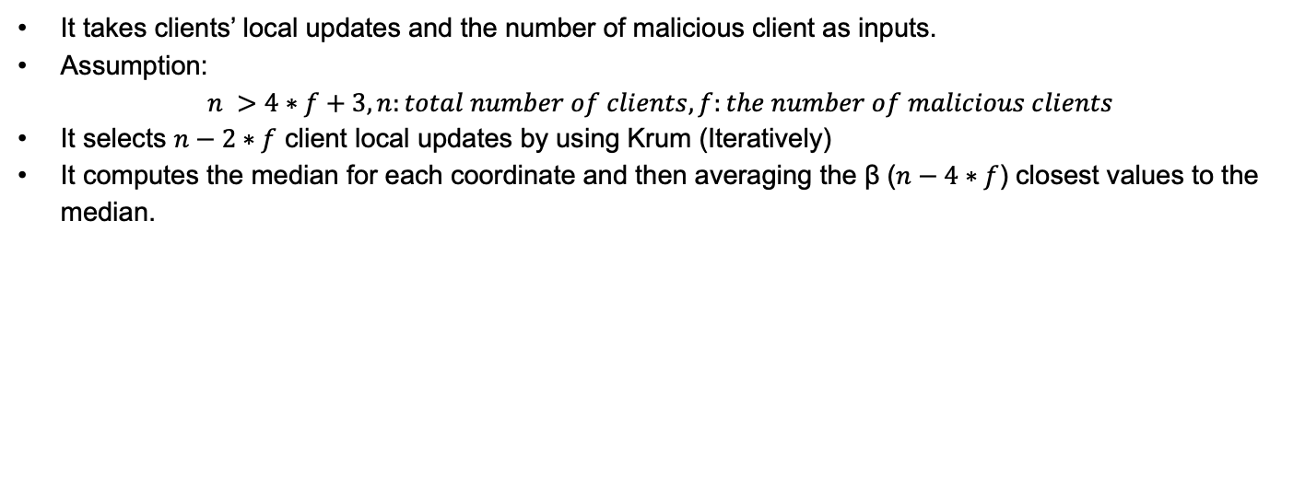
Robust Aggregation Method - Bulyan
It takes clients’ local updates and the number of malicious client as inputs.
Assumption:
$$n >4∗f+3, n:total number of clients, f:the number of malicious clients$$
It selects $n−2∗f$ client local updates by using Krum (Iteratively)
It computes the median for each coordinate and then averaging the β ($n−4∗f$) closest values to the median.

Slide 38
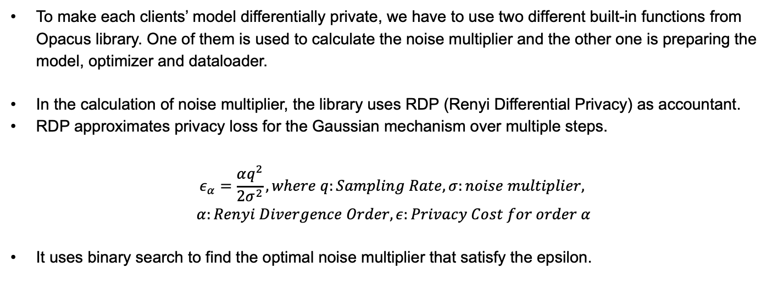
Opacus - Additional
To make each clients’ model differentially private, we have to use two different built-in functions from Opacus library. One of them is used to calculate the noise multiplier and the other one is preparing the model, optimizer and dataloader.
In the calculation of noise multiplier, the library uses RDP (Renyi Differential Privacy) as accountant.
RDP approximates privacy loss for the Gaussian mechanism over multiple steps.
$$ε_{α}=\frac{αq^{2}}{2σ^{2}}, where q:Sampling Rate, σ:noise multiplier,$$
$$α:Renyi Divergence Order, ε:Privacy Cost for order α$$
It uses binary search to find the optimal noise multiplier that satisfy the epsilon.

Slide 39
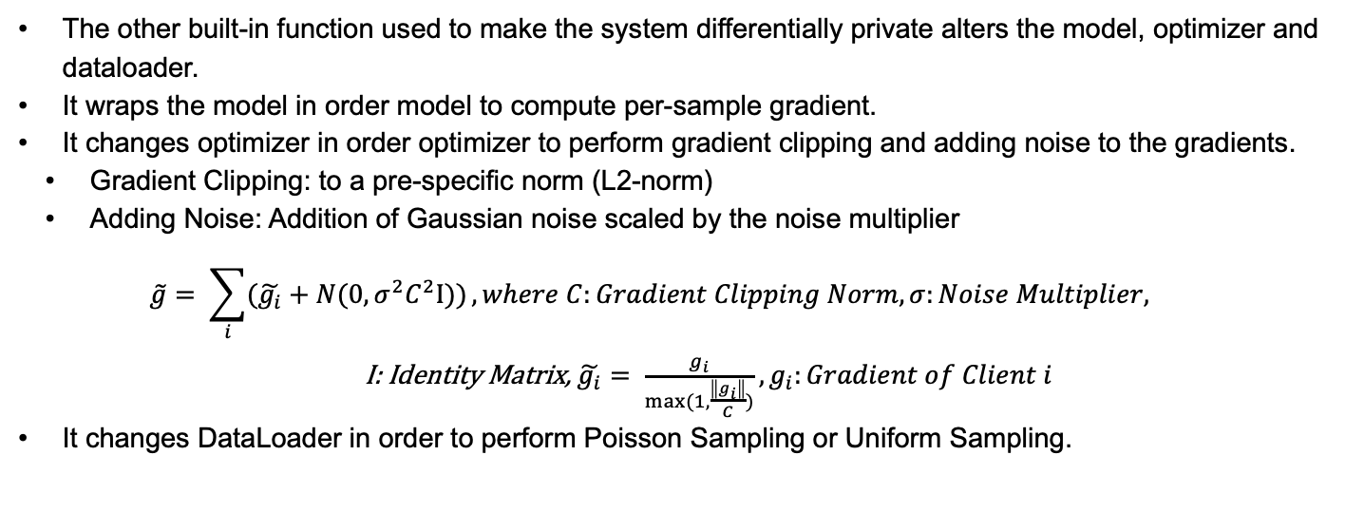
Opacus - Additional
The other built-in function used to make the system differentially private alters the model, optimizer and dataloader.
It wraps the model in order model to compute per-sample gradient.
It changes optimizer in order optimizer to perform gradient clipping and adding noise to the gradients.
Gradient Clipping: to a pre-specific norm (L2-norm)
Adding Noise: Addition of Gaussian noise scaled by the noise multiplier
$$\tilde{g}= \sum_{i}{(\tilde{g_{i}}+N(0, σ^{2}C^{2}Ι))}, where C:Gradient Clipping Norm, σ:Noise Multiplier,$$
I: Identity Matrix, $\tilde{g_{i}}= \frac{g_{i}}{max⁡(1, \frac{\left\|g_{i}\right\|}{C})}, g_{i}:Gradient of Client i$
It changes DataLoader in order to perform Poisson Sampling or Uniform Sampling.

Slide 40
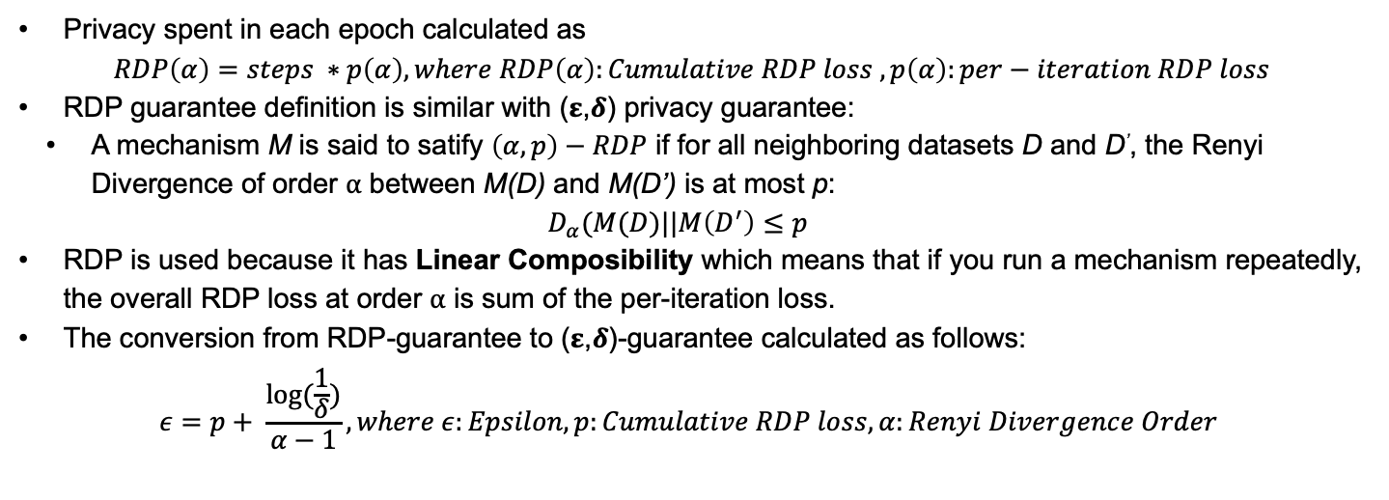
Opacus - Additional
Privacy spent in each epoch calculated as
$$RDP\left(α\right)=steps ∗p\left(α\right), where RDP\left(α\right):Cumulative RDP loss , p\left(α\right):per−iteration RDP loss$$
RDP guarantee definition is similar with (𝛆,𝜹) privacy guarantee:
A mechanism M is said to satify $\left(α,p\right)−RDP$ if for all neighboring datasets D and D’, the Renyi Divergence of order ⍺ between M(D) and M(D’) is at most p:
$$D_{α}(M(D)||M\left(D^{′}\right)≤p$$
RDP is used because it has Linear Composibility which means that if you run a mechanism repeatedly, the overall RDP loss at order ⍺ is sum of the per-iteration loss.
The conversion from RDP-guarantee to (𝛆,𝜹)-guarantee calculated as follows:
$$ε=p+ \frac{log⁡(\frac{1}{δ})}{α−1}, where ε:Epsilon, p:Cumulative RDP loss, α:Renyi Divergence Order$$

Slide 41
Label Flipping Attack
Original Label | Mapped Label
0 | 9
1 | 8
2 | 7
3 | 6
4 | 5
5 | 4
6 | 3
7 | 2
8 | 1
9 | 0

Slide 42
Inner Product Manipulation (IPM) Attack
For a model to learn correctly, the inner product of the aggregated gradient and the true gradient should be non-negative.
The IPM attack exploits this vulnerability.
The IPM attack uses the mean of the benign clients’ gradients to create malicious gradients in the opposite direction of this mean.
As a result, the inner product of the aggregated gradient and the true gradient will be negative.

Slide 43
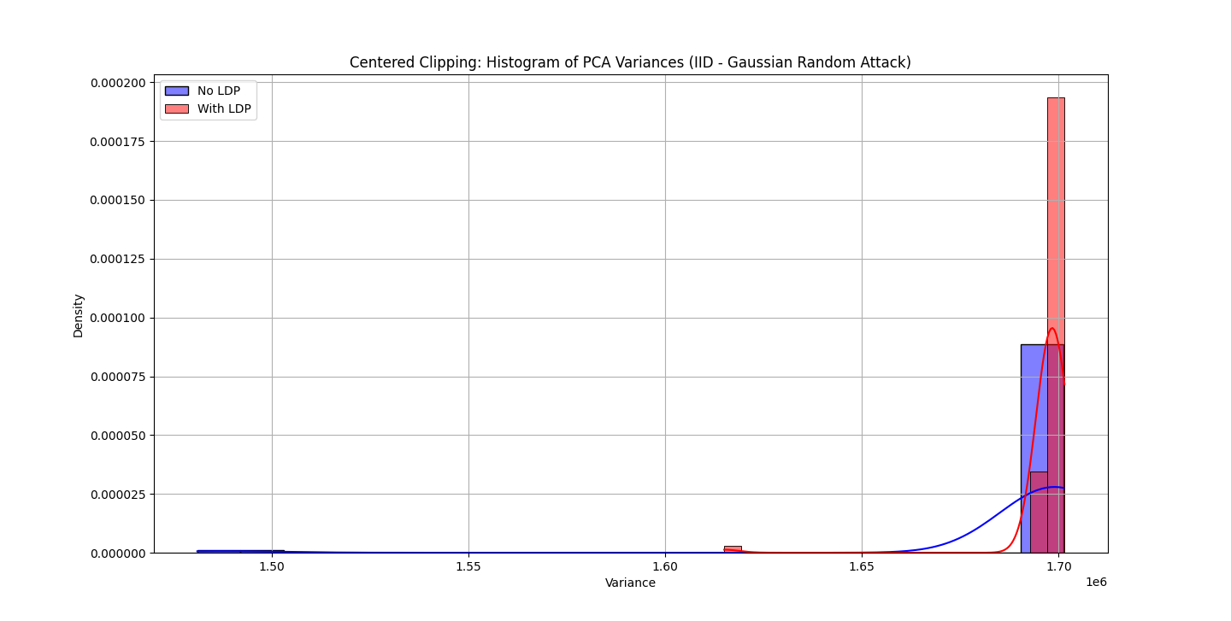
Centered Clipping Under Random Gaussian Attack (MNIST – IID)
Test accuracy drops from 98.84% to 66.38%.

Slide 44
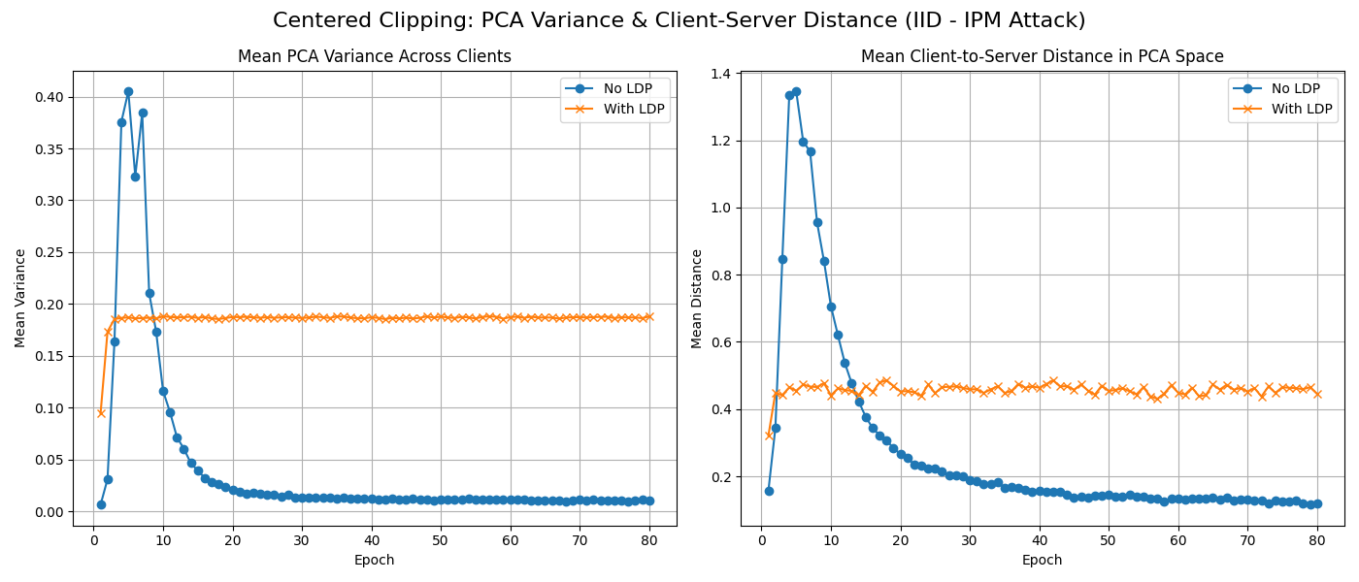
Centered Clipping Under IPM Attack (MNIST – IID)
Test accuracy drops from 98.52% to 57.21%.

Slide 45
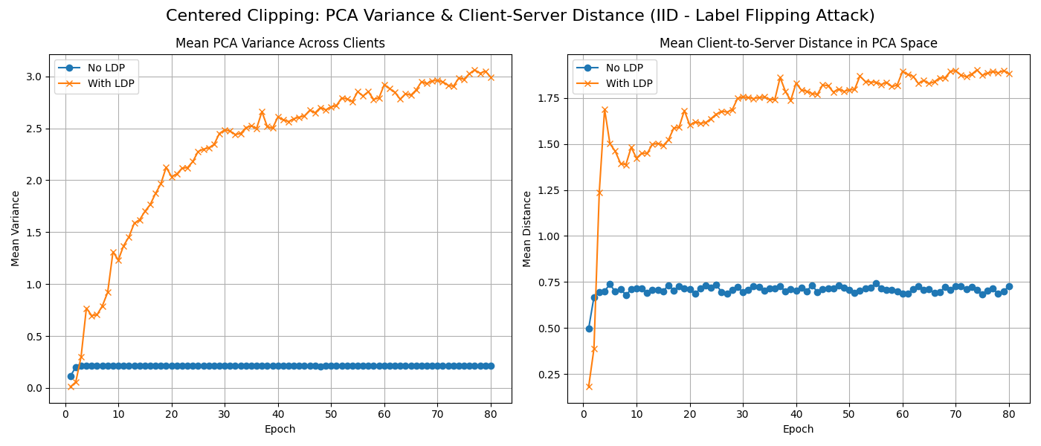
Centered Clipping Under Label Flipping Attack (MNIST – IID)
Test accuracy drops from 98.86% to 66.04%.

Slide 46

Clustering Under IPM Attack (MNIST – IID)
Test accuracy drop from 94.94% to 0.84%

Slide 47
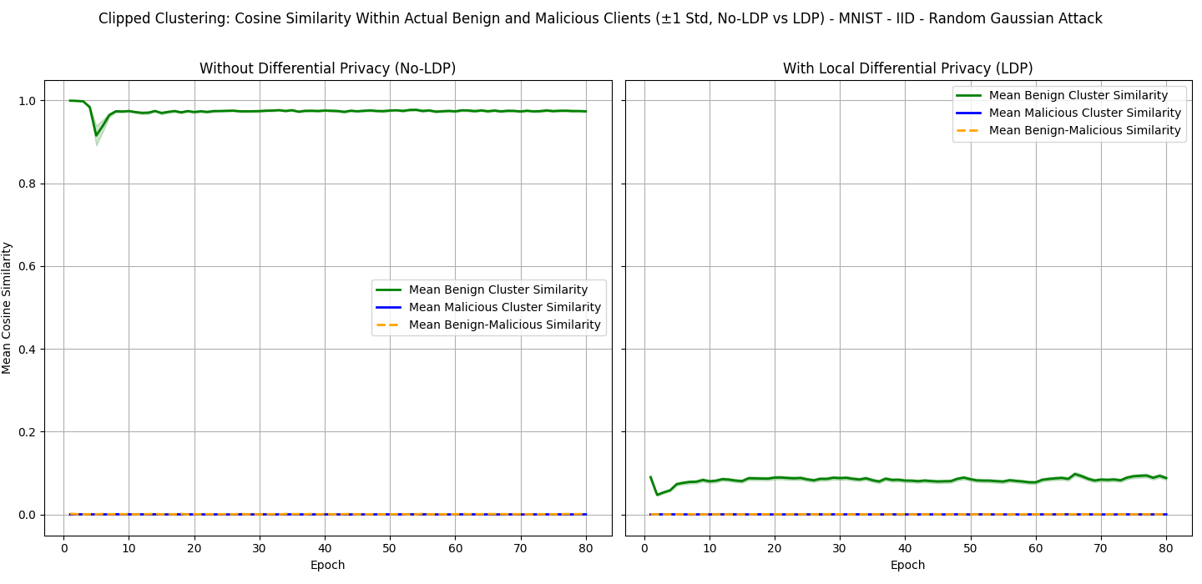
Clipped Clustering Under Random Gaussian Attack (MNIST – IID)
Test accuracy drops from 95.13% to 65.36%

Slide 48
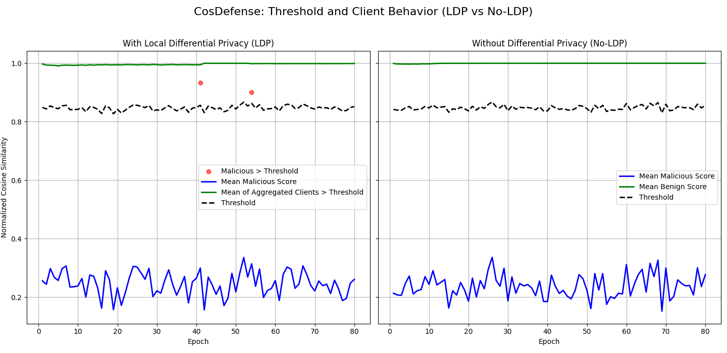
CosDefense Under Random Gaussian Attack (MNIST – IID)
Test accuracy drop from 90.44% to 56.03%

Slide 49
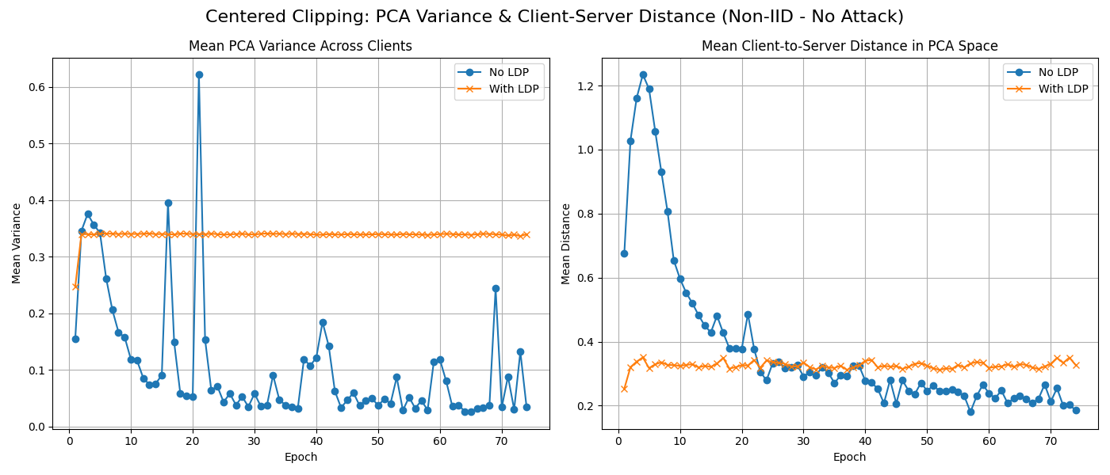
Centered Clipping Under No-Attack (MNIST – Non-IID)
Test accuracy drops from 98.79% to 67.67%.

Slide 50
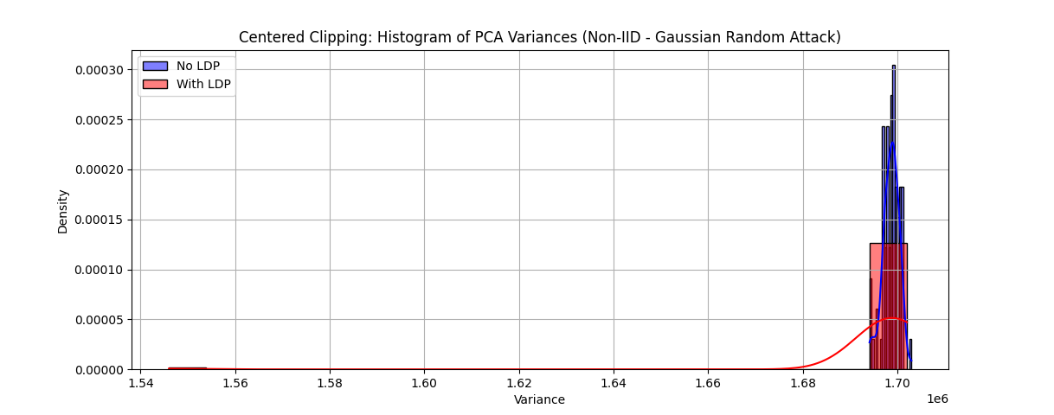
Centered Clipping Under Random Gaussian Attack (MNIST – Non-IID)
Test accuracy drops from 98.72% to 58.30%.

Slide 51
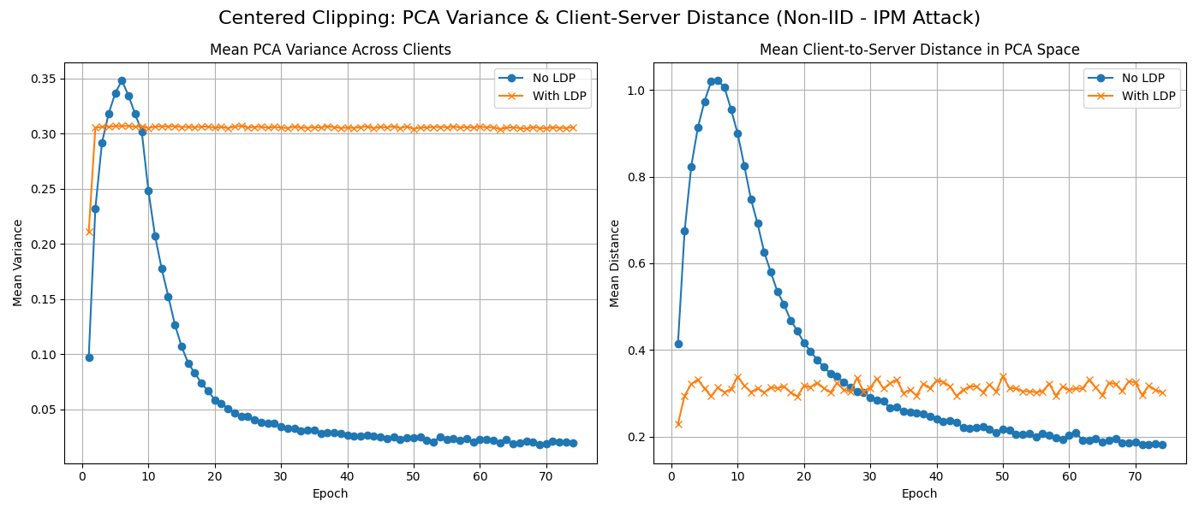
Centered Clipping Under IPM Attack (MNIST – Non-IID)
Test accuracy drops from 98.11% to 21.52%.

Slide 52
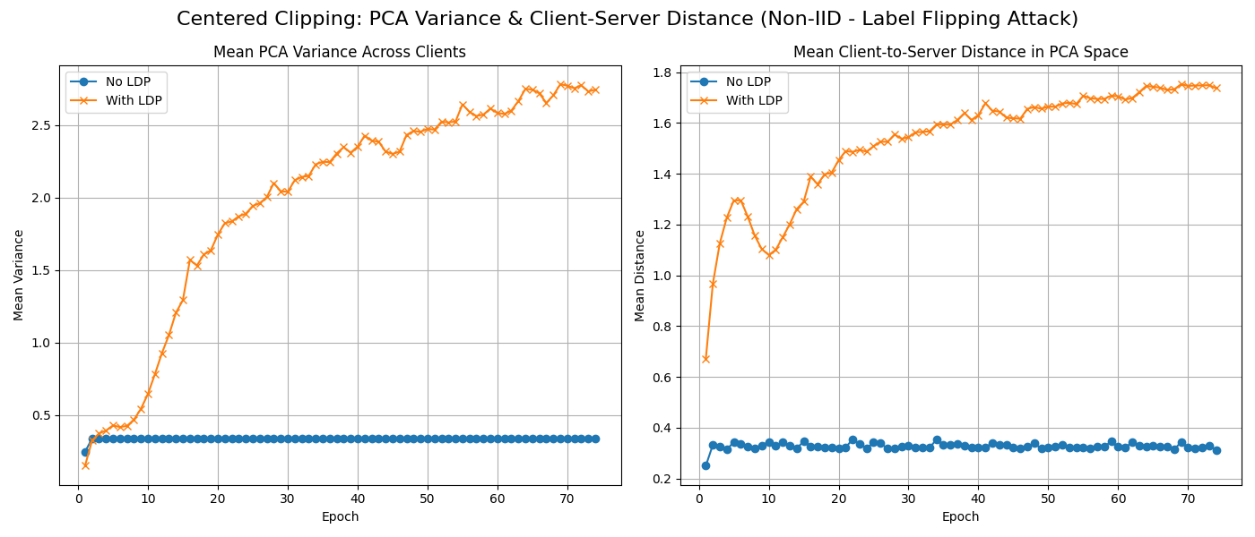
Centered Clipping Under Label Flipping Attack (MNIST – Non-IID)
Test accuracy drops from 98.65% to 52.00%.

Slide 53
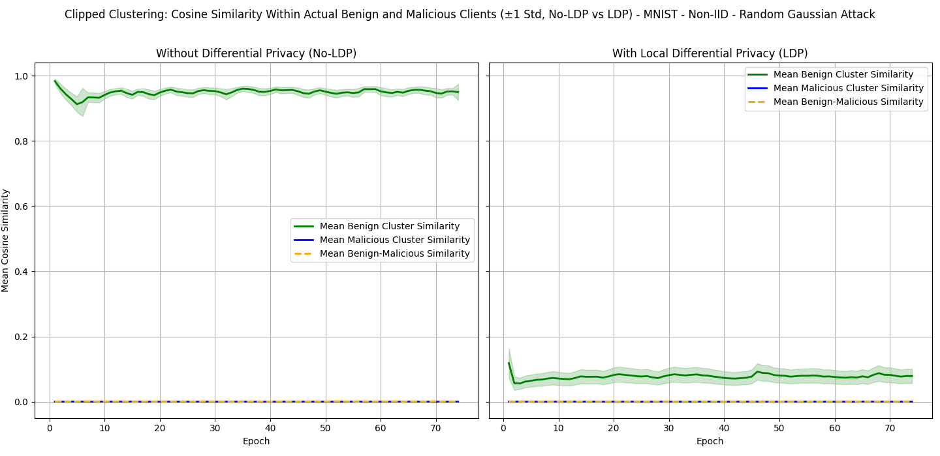
Clipped Clustering Under Random Gaussian Attack (MNIST – Non-IID)
Test accuracy drops from 93.85% to 61.05%

Slide 54
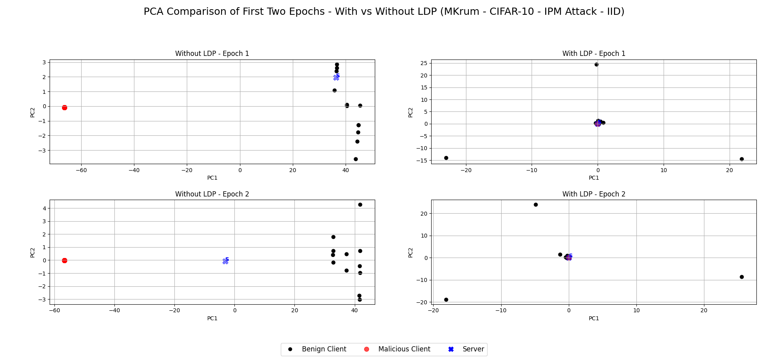
MKrum Under IPM Attack (CIFAR-10 – IID)
Test accuracy drops from 74.81% to 14.43%.

Slide 55
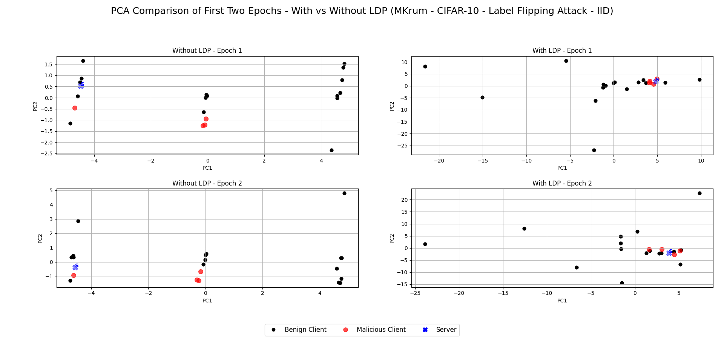
MKrum Under Label Flipping Attack (CIFAR-10 – IID)
Test accuracy drops from 76.32% to 31.81%.

Slide 56
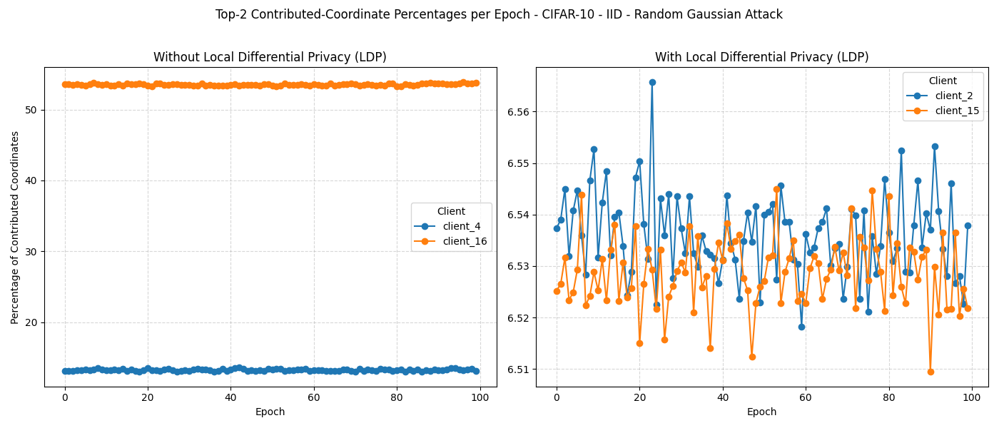
Median Under Random Gaussian Attack (CIFAR-10 – IID)
Test accuracy drops from 72.32% to 11.27%.

Slide 57
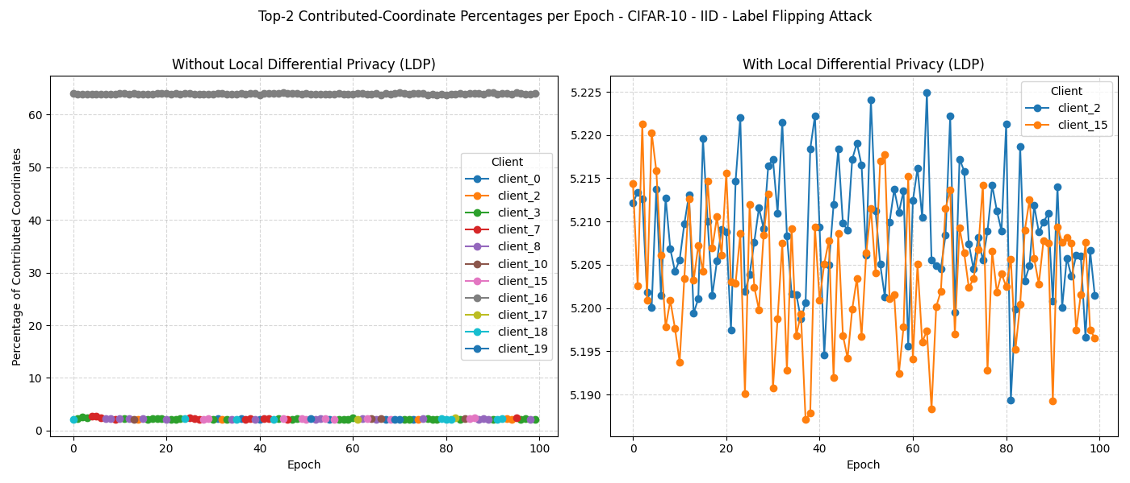
Median Under Label Flipping Attack (CIFAR-10 – IID)
Test accuracy drops from 75.53% to 11.87%.

Slide 58
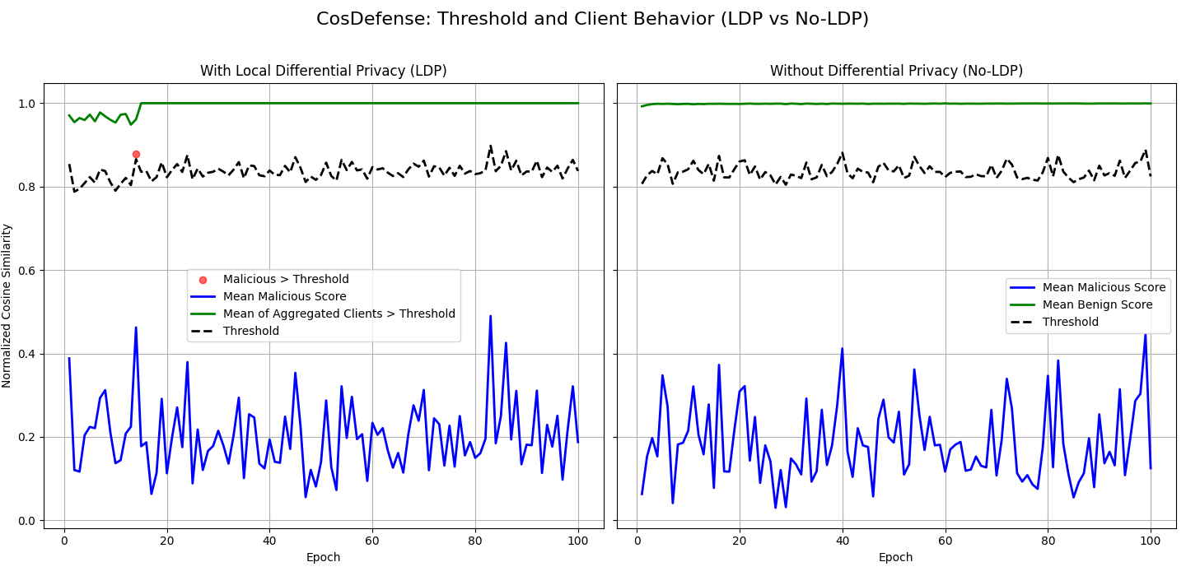
CosDefense Under Random Gaussian Attack (CIFAR-10 – IID)
Test accuracy drops from 80.10% to 11.75%.

Slide 59
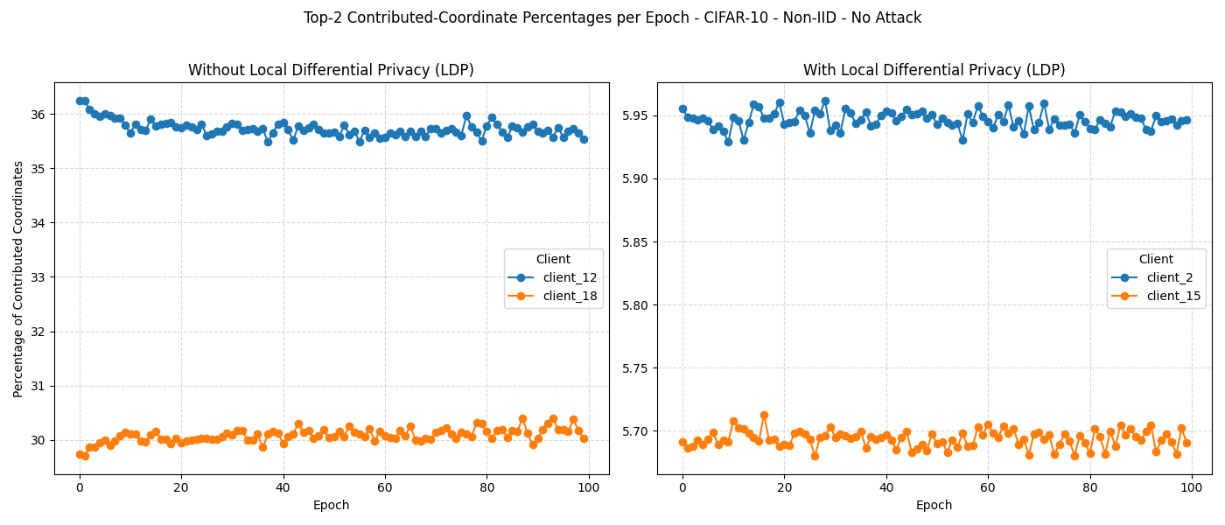
Median Under No-Attack (CIFAR-10 – Non-IID)
Test accuracy drops from 72.86% to 10.00%.

Slide 60
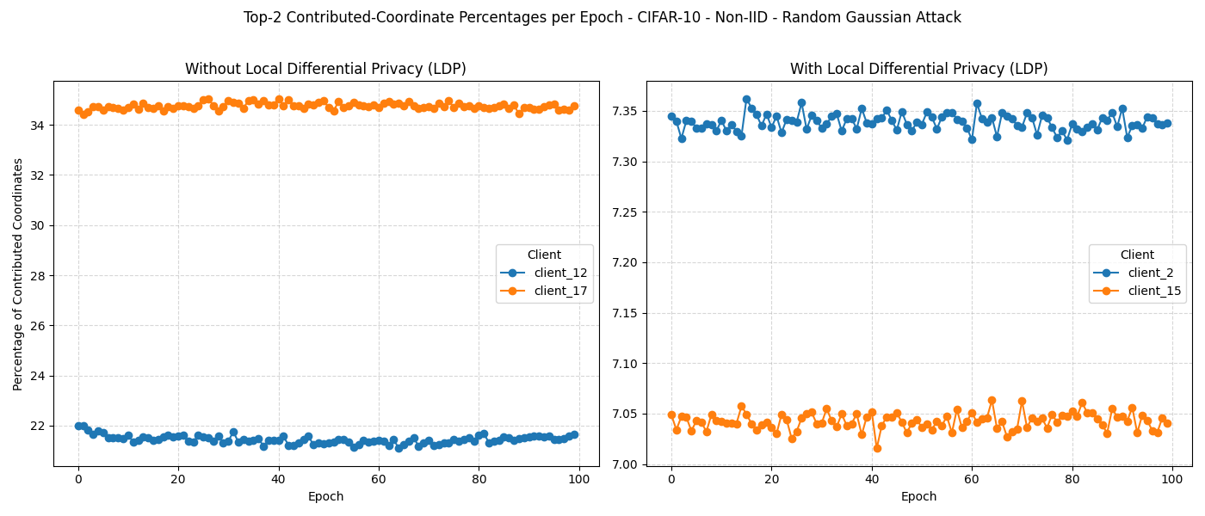
Median Under Random Gaussian Attack (CIFAR-10 – Non-IID)
Test accuracy drops from 62.30% to 10.00%.

Slide 61
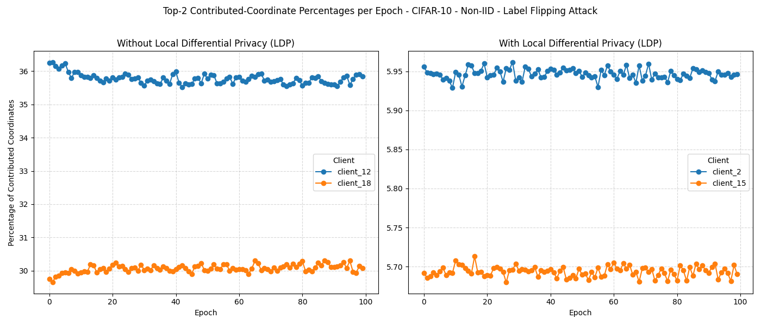
Median Under Label Flipping Attack (CIFAR-10 – Non-IID)
Test accuracy drops from 68.71% to 10.00%.

Slide 62
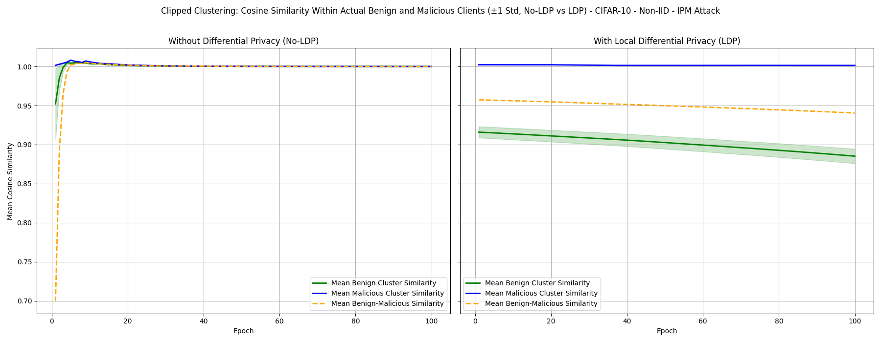
Clipped Clustering Under IPM Attack (CIFAR-10 – Non-IID)
Test accuracy drops from 59.20% to 37.55%.

Slide 63
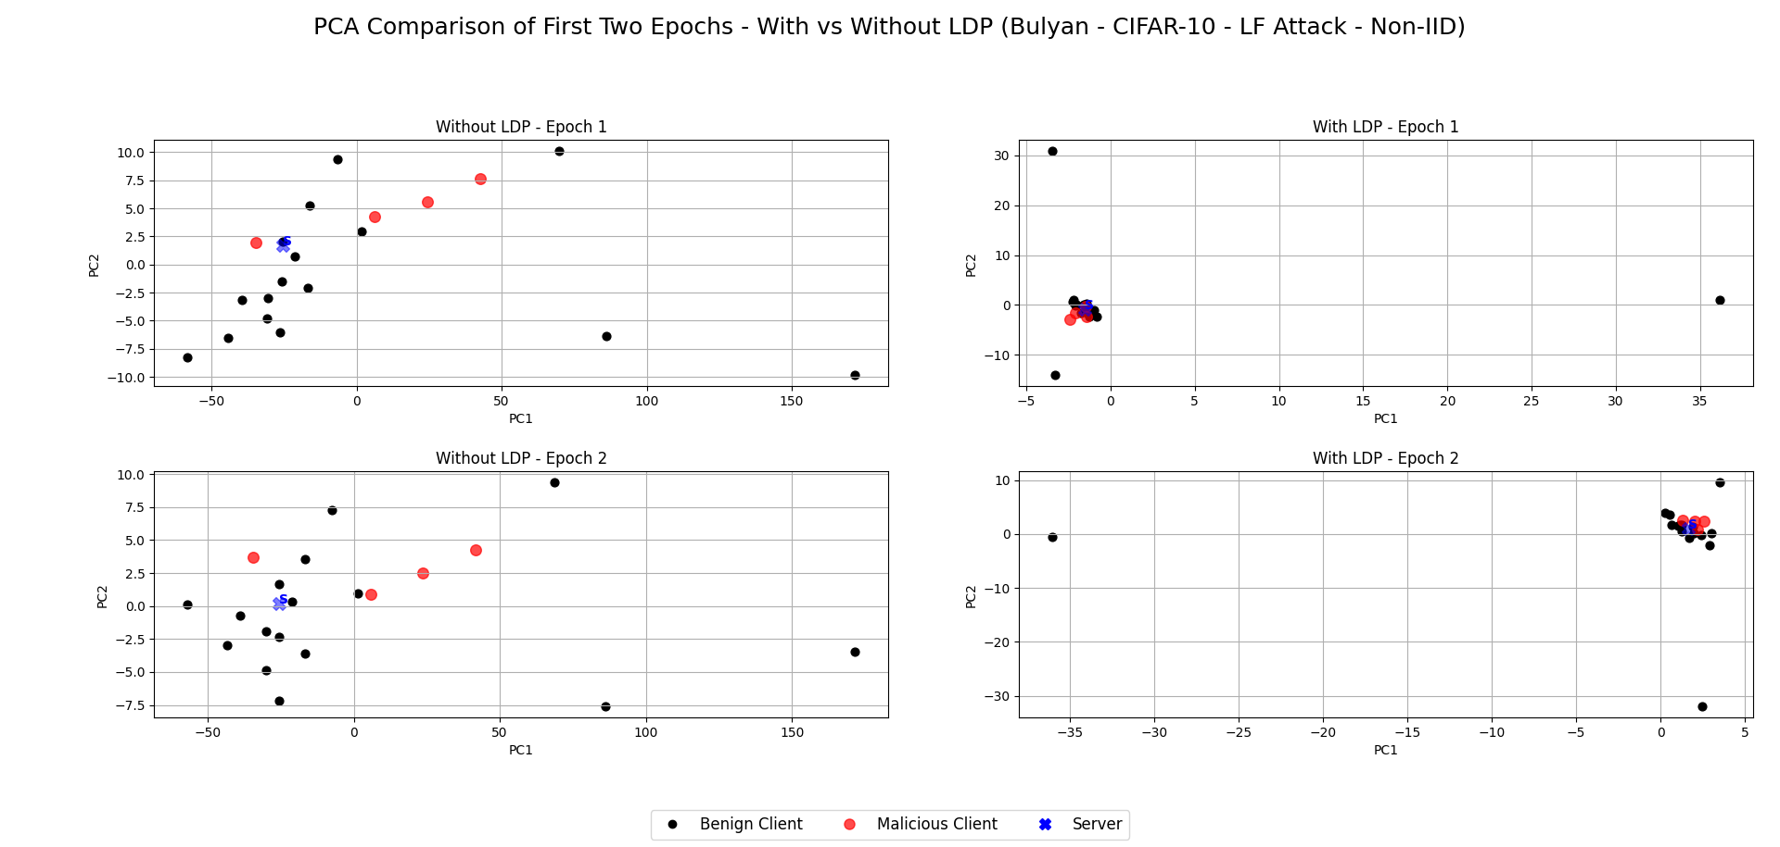
Bulyan Under Label Flipping Attack (CIFAR-10 – Non-IID)
Test accuracy drops from 68.87% to 38.22%.

Slide 64
Experimental Setup
Dataset | MNIST | CIFAR-10
Model | CNN | Resnet18
Number of Epochs | 80 | 100
Number of Client | 100 | 20
Local Iteration | 1 | 1
Batch Size | 64 | 128
Dirichlet Alpha | 100 (IID), 0.5 (Non-IID) | 100 (IID), 0.5 (Non-IID)
Epsilon | 5 | 8
Delta | 1e-03 | 1e-03
Gradient Clipping | 2.0 | 2.0
Attack Types | Random Gaussian, IPM, LF | Random Gaussian, IPM, LF
Percentage of Malicious Clients | 20% for Random Gaussian and LF, and 40% for IPM | 20% for Random Gaussian and LF, and 40% for IPM
Learning Rate | 0.05 | 0.05 (No-LDP), 0.1 (LDP)

